Slide 2
Nano Server - All you need to know

Slide 3
About me
Mike Resseler
Director, Product Management @ Veeam Software
@MikeResseler

Slide 4

Introduction
Packages, Advanced & More
Management
In Depth Troubleshooting
A bit more?
Q&A

Slide 5
Introduction
Aka: the basics

Slide 6

A Headless, 64-bit Server
NOT an installation option
Packages
Intented for «Cloud Fabrics»
Intended for «Born-in-the-Cloud» apps

Slide 7

Rebooting impacts business
Server images too big
High infrastructure requirements
Security impact

Slide 8

As it is today…
Roles and Features
GUI Shell
Full Server
Minimal Server Interface
Windows/ Windows NT
Server Core
Server Core
Windows NT to Windows Server 2003
Windows Server 2008 and Windows Server 2008 R2
Windows Server 2012 and Windows Server 2012 R2

Slide 9

The next step in the journey…
Nano Server: A new headless, 64-bit only, deployment option for Windows Server
Deep refactoring with cloud emphasis
Cloud fabric & infrastructure (clustering, storage, networking)
Born-in-the-cloud applications (PaaS v2, ASP.NET v5)
VMs & Containers (Hyper-V & Docker)
Extend the Server Core pattern
Roles & features live outside of Nano Server
No Binaries or metadata in OS image
Standalone packages install like apps
Full driver support
Antimalware
Server with a Desktop Experience
Server Core
Nano Server

Slide 10
Servicing improvements*
Important
bulletins
Critical
bulletins
Reboots
required
* Analysis based on all patches released in 2014

Slide 11
Security improvements
Drivers loaded
Services
running
Ports open

Slide 12
Resource utilization improvements
Process
Count
Boot IO
(MB)
Kernel Mem
in Use (MB)

Slide 13
Deployment improvements
Setup Time
(Sec)
Disk Footprint
(GB)
VHD Size
(GB)

Slide 14

Quick Start
PowerShell Module
3 cmdlets
No more DISM necessary

Slide 15
Examples
# Simple Nano Server (as a virtual machine)
New-NanoServerImage -Edition Datacenter -DeploymentType Guest -MediaPath E:\ -BasePath .\Base -TargetPath .\NanoServerVMS\Nano02\Nano02.vhdx -ComputerName Nano02
# Simple Nano Server (physical, cluster, hyper-v host)
New-NanoServerImage -Edition Datacenter -DeploymentType Host -BasePath .\Base -TargetPath .\NanoServerVMS\NanoPhys01\NanoPhys01.vhd -ComputerName NanoPhys01 -OEMDrivers –Compute -Clustering

Slide 16
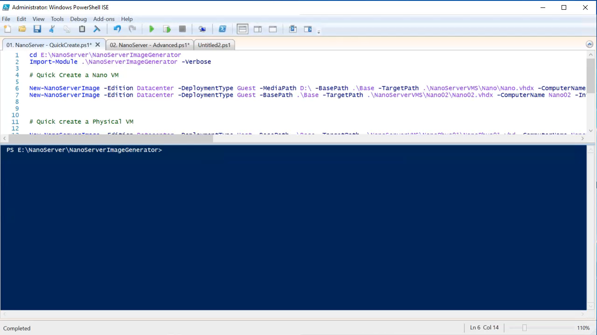
Demo
Quick Start

Slide 17
Packages
Advanced deployment and More

Slide 18
Role / Feature | Filename on ISO
Hyper-V | Microsoft-NanoServer-Compute-Package
Failover Clustering | Microsoft-NanoServer-FailoverCluster-Package
Basic drivers | Microsoft-NanoServer-OEM-Drivers-Package
File Server role and other storage components | Microsoft-NanoServer-Storage-Package
Windows Defender (including a default signature file) | Microsoft-NanoServer-Defender-Package
Reverse forwarders | (Included by default)
DNS Server role | Microsoft-NanoServer-DNS-Package
Desired State Configuration (DSC) | Microsoft-NanoServer-DSC-Package
Internet Information Server (IIS) | Microsoft-NanoServer-IIS-Package
Host support for Windows Containers | Microsoft-NanoServer-Containers-Package
System Center Virtual Machine Manager agent | Microsoft-Windows-Server-SCVMM-Compute-Package Microsoft-Windows-Server-SCVMM-Package
Network Performance Diagnostics Service (NPDS) | Microsoft-NanoServer-NPDS-Package
Data Center Bridging | Microsoft-NanoServer-DCB-Package
Deploying on a virtual machine | Microsoft-NanoServer-Guest-Package
Deploying on a physical machine | Microsoft-NanoServer-Host-Package
Secure Startup | Microsoft-NanoServer-SecureStartup-Package
Shielded VM | Microsoft-NanoServer-ShieldedVM-Package

Slide 19

PowerShell cmdlets
New-NanoServerImage
Get-NanoServerPackages
Edit-NanoServerImage

Slide 20
Parameter | Explanation
-AdministratorPassword | This sets the image’s administrator password. If you do not specify this on the command line, you will be interactively prompted to do.
-BasePath | This is the location for the copy of the source media. It will be under a folder (auto-created if not exist) and contains the packages, tools, hard disk image and WIM file.
-Clustering | This allows you to add the clustering role.
-Compute | With this, you can add the Compute (Hyper-V) role.
-ComputerName | This sets the computer name of the image. Note that the computer name can’t be longer than 15 characters
-Containers | This allows you to add the Containers role.
-CopyPath | This parameter specifies additional directory path on the computer where you create the image and that directory and the files in it will be added to the root of the VHD(X).
-DebugMethod | With this parameter, you will enable kernel debugging on the target image with the specified method. The values can be Serial, Net, 1394 or USB Depending on the value of this parameter, other parameters may become available. See kernel debugging for more information.
-Defender | This adds the Windows Defender feature.
-DeploymentType | Guest or host, depending on whether you want to deploy a virtual or physical nano server
-Development | Used to test on Nano server which allows unsigned drivers, copy debugger binaries and so on
-DomainBlobPath | This lets you Join the image to the domain as specified in the given domain blob. For more information, see the chapter about domain join.
-DomainName | This joins the image to the specified domain performing an offline join. For more information, see the chapter about domain join.
-DriversPath | If you need additional drivers or specific ones instead of the OEM drivers, you can add them with this parameter. It should point to the path containing the drivers (.inf and binaries). Note that the drivers need to be signed, otherwise the command will fail.
-EMSBaudRate | This is the baud rate to use for EMS. The default is 115200bps.

Slide 21
Parameter | Explanation
-EMSPort | This is the port to enable EMS on. The default is 1.
-Edition | Standard or Datacenter, the windows edition you want to deploy
-EnableEMS | This enables EMS (Emergency Management Services) and BootEMS on the image. See Emergency Management Services for more information.
-EnableRemoteManagementPort | This parameter opens port 5985 for inbound TCP connections for Windows Remote Management (WinRM). See Windows Remote Management for more information.
-InterfaceNameOrIndex | If you want to change the IP settings of an adapter, you need to use this parameter in conjunction with the below IP parameters. You can retrieve these using Get-NetAdapter, netsh or EMC if you already created an image, and in a VM, the first will always be named Ethernet.
-Ipv4Address | This sets the given IPv4 static address on the interface specified by InterfaceNameOrIndex.
-IPv4Dns | This sets the given IPv4 DNS server (can be multiple DNS servers) on the interface specified by InterfaceNameOrIndex
-Ipv4Gateway | This sets the given IPv4 gateway on the interface specified by InterfaceNameOrIndex.
-Ipv4SubnetMask | This sets the given IPv4 subnet mask on the interface specified by InterfaceNameOrIndex
-Ipv6Address | This sets the given IPv6 static address on the interface specified by InterfaceNameOrIndex.
-Ipv6Dns | This sets the given IPv6 DNS server on the interface specified by InterfaceNameOrIndex
-LogPath | This sets the location where you want to save the logs created while building the image
-MaxSize | Size in bytes of the dynamic VHD(X) to be created. Default is 4 GB.

Slide 22
Parameter | Explanation
-MediaPath | The location of the source media. If a local copy of the source media already exists, and it is specified as the base path, then no copying is performed. This is the downloaded ISO that you either have mounted or copied to a specific location. This is only necessary the first time.
-OEMDrivers | This is used to add the OEM Drivers package. Those drivers are the same set of drivers that exists in Server Core.
-OfflineScriptArgument | This accepts an hashtable of arguments when you want to add a customer script (see next)
-OfflineScriptPath | This accepts an array of paths to PowerShell scripts, with a possibility to pass arguments through the OfflineScriptArgument
-Package | Include the following packages separated by a comma. This is the specific parameter that adds the packages that don’t have a specific parameter. See the Packages chapter for more information.
-ReuseDomainNode | When joining a domain, reuse a node with the same name if it exists. For more information, see the chapter about domain join.
-ServicingPackages | With this parameter you can add servicing packages (multiple is possible) that you downloaded from the Microsoft Update catalog
-SetupCompleteCommand | You can add here custom commands as part of setupcomplete.cmd
-SetupUI | Is more or less the same as the packages option, but is used internally by the Nano Server Image Builder (see below) and the recommended way is still to use the -packages parameter
-Storage | This adds the Storage role
-TargetPath | This is the location of the final, modified image. The image format is determined based on the file extension. Possible extension values are .VHD and .VHDX. VHD will come with MBR and VHDX with GPT disk layout.
-UnattendPath | Location to add your own, custom, unattend.xml file

Slide 23
Examples
# Simple Nano Server (as a virtual machine)
New-NanoServerImage -DeploymentType Guest -Edition Datacenter -TargetPath .\NanoServerVMs\Nano03\Nano03.vhdx -BasePath .\Base -Clustering -Compute -ComputerName Nano03 -CopyPath F:\Scripts -DomainName MR.local -EnableRemoteManagementPort -InterfaceNameOrIndex ethernet -Ipv4Address 192.168.1.173 -Ipv4Dns 192.168.1.151 -Ipv4Gateway 192.168.1.1 -Ipv4SubnetMask 255.255.255.0 -MaxSize 100GB
# Simple Nano Server (as a virtual machine)
New-VM -VHDPath .\NanoServerVMs\Nano03\Nano03.vhdx -Generation 2 -MemoryStartupBytes 268435456 -Name Nano03 -Path F:\VM -SwitchName LAN

Slide 24

Additional information
Domain Join
Joining the same domain as the image creation computer
Joining a different domain
Reusing a domain account
Online domain join
Using unattend.xml
For Azure
Available in the Gallery
Bring your own disk

Slide 25
Online installation
Save-Module -Path "$env:ProgramFiles\WindowsPowerShell\Modules" -Name NanoServerPackage -MinimumVersion 1.0.0.0
Import-PackageProvider NanoServerPackage -Force
Find-NanoServerPackage
Find-NanoServerPackage –AllVersions -Name *IIS* -RequiredVersion 10.0.14393.0 -Culture en-us
# Installation to an offline image
Install-NanoServerPackage -Name Microsoft-NanoServer-IIS-Package -Culture en-us -RequiredVersion 10.0.14393.0 –ToVHd D:\MyNanoVhd.vhdx
# Download without installation
Save-Package –provider NanoServerPackage -Name Microsoft-NanoServer-IIS-Package -Path .\temp -Culture en-us -MinimumVersion 10.0.14300.1000
# Install directly
Install-NanoServerPackage -Name Microsoft-NanoServer-IIS-Package -Culture en-us -RequiredVersion 10.0.14393.0

Slide 26
Management
Is not what it seems… or is it?

Slide 27

Managing Options
Yes PowerShell, No PowerShell
Nano Server Recovery Console
PowerShell Remoting / Direct
Windows PowerShell CIM
Windows Remote Management
Remote Consoles
Remote Server Management Tools

Slide 28

Nano Server Recovery Console
Formerly called Emergency Management Console
Possibility to edit IP settings
Possibility to edit Route table
Possibility to edit Firewall Rules *
Shutdown / Restart Server

Slide 29
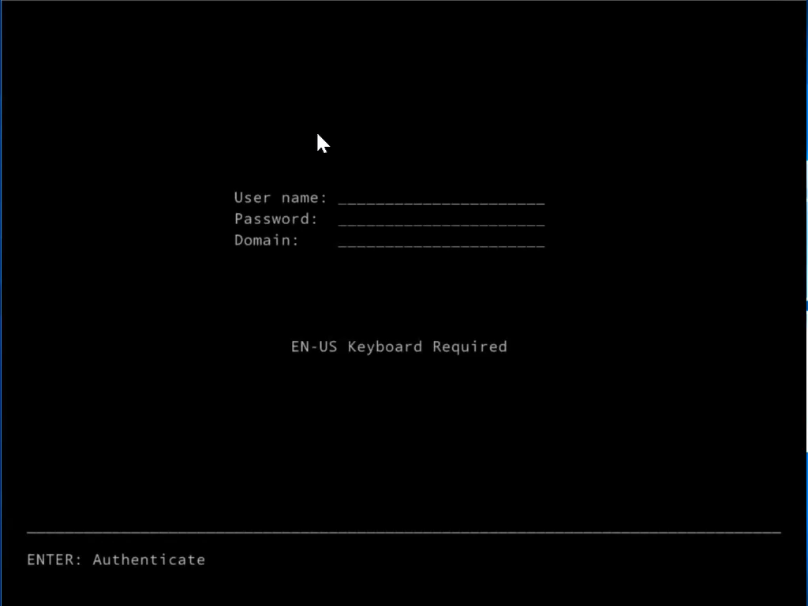

Slide 30
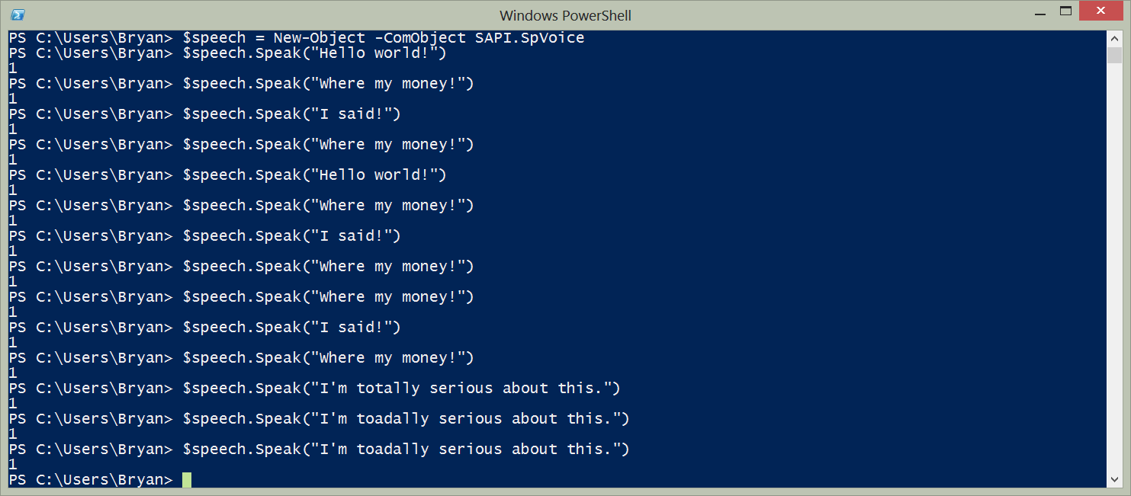
PowerShell Remoting / Direct
Should be mostly used
Remoting requires network
Direct uses VMbus

Slide 31
PowerShell cmdlets not supported
ADSI, ADO, and WMI type adapters
Enable-PSRemoting, Disable-PSRemoting (PowerShell remoting is enabled by default; see the "Using Windows PowerShell Remoting" section of Getting Started with Nano Server).
Scheduled jobs and PSScheduledJob module
Computer cmdlets for joining a domain { Add | Remove } (for different methods to join Nano Server to a domain, see the "Joining Nano Server to a domain" section of Getting Started with Nano Server).
Reset‑ComputerMachinePassword, Test‑ComputerSecureChannel
Profiles (you can add a startup script for incoming remote connections with Set-PSSessionConfiguration)
Clipboard cmdlets
EventLog cmdlets { Clear | Get | Limit | New | Remove | Show | Write } (use the New-WinEvent and Get-WinEvent cmdlets instead).
Get-PfxCertificate cmdlet
TraceSource cmdlets { Get | Set }
Counter cmdlets { Get | Export | Import }
Web-related cmdlets { Invoke-WebRequest, Invoke-RestMethod, New-WebServiceProxy, Send-MailMessage, ConvertTo-Html }
Logging and tracing using PSDiagnostics module
Get-HotFix (to obtain and manage updates on Nano Server, see Managing Updates in Nano Server).
Implicit remoting cmdlets { Export-PSSession | Import-PSSession }
New-PSTransportOption
PowerShell transactions and Transaction cmdlets { Complete | Get | Start | Undo | Use }
PowerShell Workflow infrastructure, modules, and cmdlets
Out-Printer
Update-List
WMI v1 cmdlets: Get-WmiObject, Invoke-WmiMethod, Register-WmiEvent, Remove-WmiObject, Set-WmiInstance (use CimCmdlets module instead.)

Slide 32
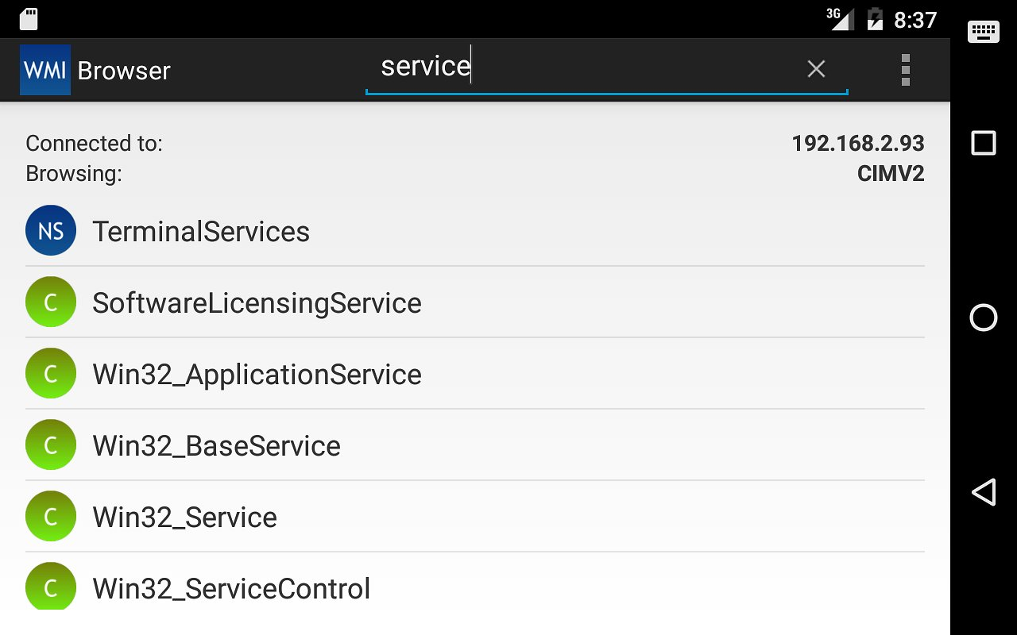
Windows PowerShell CIM
Over WinRM
Use it to run WMI commands

Slide 33

Windows Remote Management
WinRM = MSFT version of WS-Man
Runs programs remotely on Nano

Slide 34
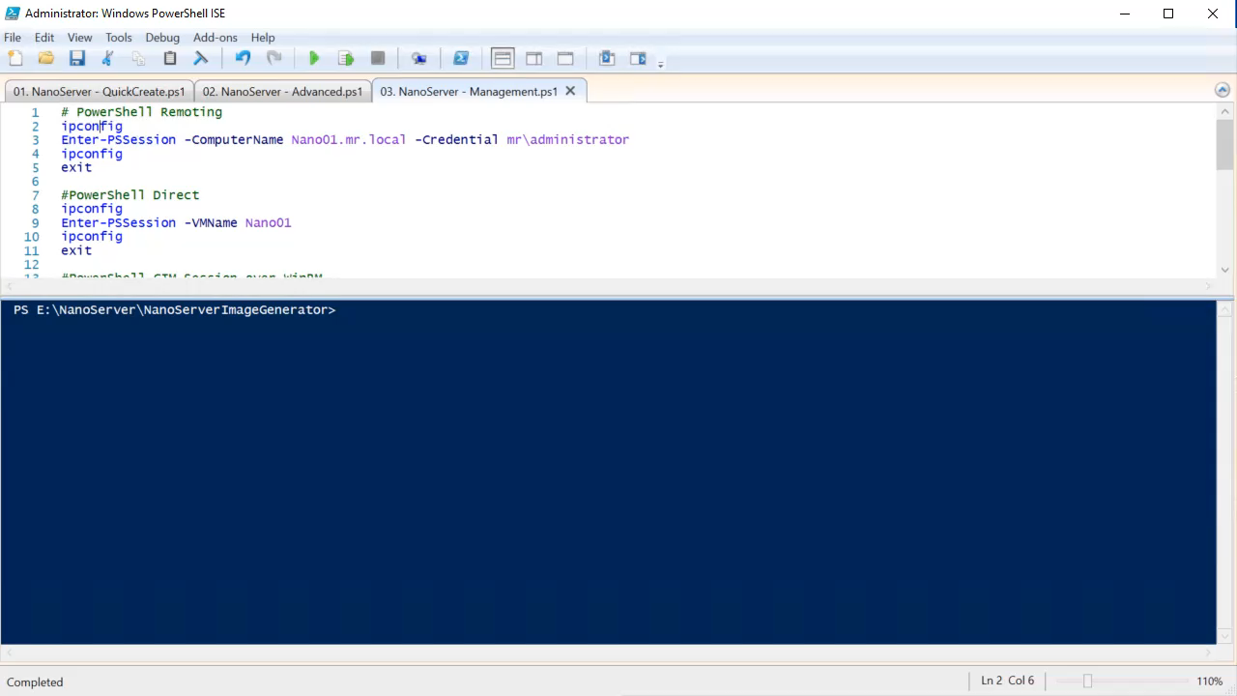

Slide 35

Remote Consoles
Most MMC Consoles will work
Hyper-V Manager
Cluster Failover Manager
DNS
Server Manager
...

Slide 36
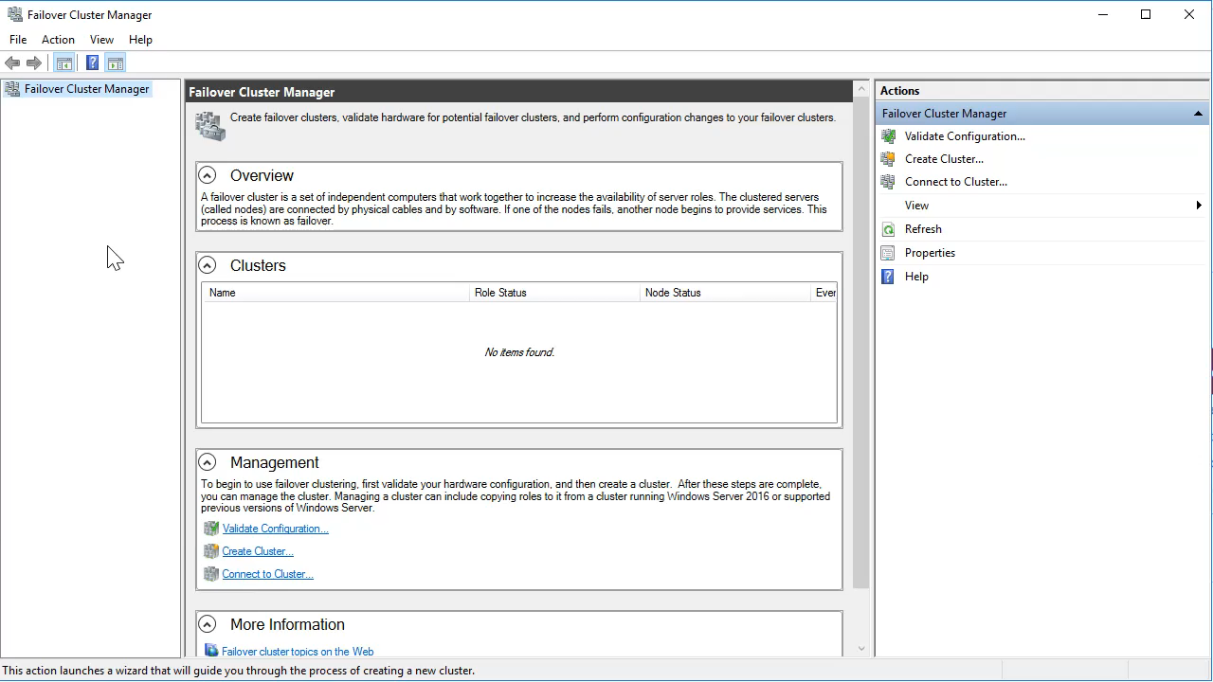

Slide 37
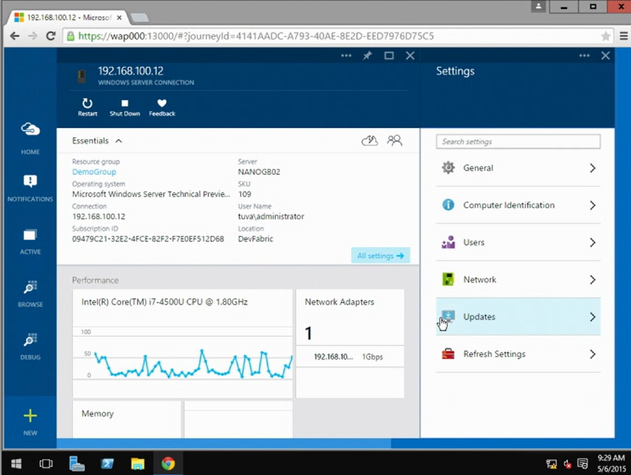
Remote Server Management Tools
Web-based tools (in Azure)
Replacement for local-only tools
Gateway on-prem necessary

Slide 38
In Depth
Troubleshooting

Slide 39


Setup & Boot Eventlog collection
Greater Visibility
Remotely view debug errors, events from your deployment process, boot loader, OS, and services
Troubleshoot issues without requiring physical access
Physical Machines
Virtual Machines
ETW Messages
Simple Setup
Works on both physical and virtual machines
Requires little additional infrastructure and can be set up using PowerShell or an unattend file
ETW Collector
Service
ETL Files
Lower MTTR
Access to data is real-time and can be correlated with other diagnostic data to identify problems faster
Analysis Tools

Slide 40

New feature in Windows Server 2016
A push operation, not pull
Message Analyzer
Or tool of choice...

Slide 41
Kernel Debugging
Also possible with Nano Server
Over serial port
Over TCP/IP
Over FireWire
Over USB
Needs to be done upfront

Slide 42
Kernel Debugging
# deploy parameters for Serial
-DebugMethod Serial -DebugCOMPort 1 -DebugBaudRate 9600
# deploy parameters for TCP/IP
-DebugMethod Net -DebugRemoteIP 192.168.1.100 -DebugPort 64000
# deploy parameters for FireWire
-DebugMethod 1394 -DebugChannel 3
# deploy parameters for USB
-DebugMethod USB -DebugTargetName <name>

Slide 43
Performance & Event monitoring
wpr.exe (windows performance recorder tool)
Event Tracing Management cmdlets
Typeperf.exe (cmdline equivalent of perfmon GUI)
Get-Winevent (remotely read event viewer)
Wevtutil.exe (Retrieve information from event logs and specific publishers)

Slide 44

Emergency Management Service
Serial Console interface in bootloader
Enabled by default in most cases but...
NOT in Nano Server
-EnableEMS -EMSPort 3 -EMSBaudRate 9600

Slide 45
A bit
More

Slide 46
MORE?
A bit more...
DISM – SetupComplete.cmd – Unattend.xml
DNS Package – Needs to be enabled
IIS – does not support everything
Hyper-V – No RemoteFX
Clustering – No cmdlets local on Nano Server
Clustering – Only File / Hyper-V
Accessing DFS – additional config

Slide 47
Want more?
Nano Server Management for GUI Lovers
Aleksandar Nikolic/Jan Egil Ring
Tomorrow 12:40 – 13:40 Room 3

Slide 48
Thank you
Download the ebook @
https://hyperv.veeam.com/windows-nano-server-all-you-need-to-know-7708/

Slide 49
Picture References
Slide 4: https://www.flickr.com/photos/77144005@N00/29789408/
Slide 6, 40: http://www.flickr.com/photos/49462908@N00/3556697439/
Slide 7: https://www.flickr.com/photos/tie_ler/5969283186/
Slide 8: https://www.flickr.com/photos/107563722@N04/25156347003/
Slide 9: https://www.flickr.com/photos/116451027@N08/26133978331/
Slide 19: https://www.flickr.com/photos/46191841@N00/3734200307/
Slide 24: https://www.flickr.com/photos/35034358326@N01/1069893367/
Slide 28: https://www.flickr.com/photos/flyzipper/107043835/
Slide 29: https://www.flickr.com/photos/altemark/1598056760/in/photostream/
Slide 30: https://www.flickr.com/photos/7160940@N02/9217848637/
Slide 33: https://www.flickr.com/photos/39442289@N00/2340521934/
Slide 39: https://www.flickr.com/photos/tampaempire/4420936023/
Slide 43: https://www.flickr.com/photos/10581663@N08/23974926883/

